Slide 1

SoEN 6441 Advanced Programming Practices Project -Winter 2024
Build 2:
Submitted by: Team 09
Jayasurya Pazhani [40289512]
Jayanth Apagundi [40291184]
Shuvanidhi Suresh [40293590]
Shahul Hameed [40290787]
Vinisha Kora Venkatesalu [40293927]
Submitted to:
Professor Joey Paquet

Slide 2
AGENDA
Architecture Diagram
State Pattern
Observer Pattern
Command Pattern

Slide 3
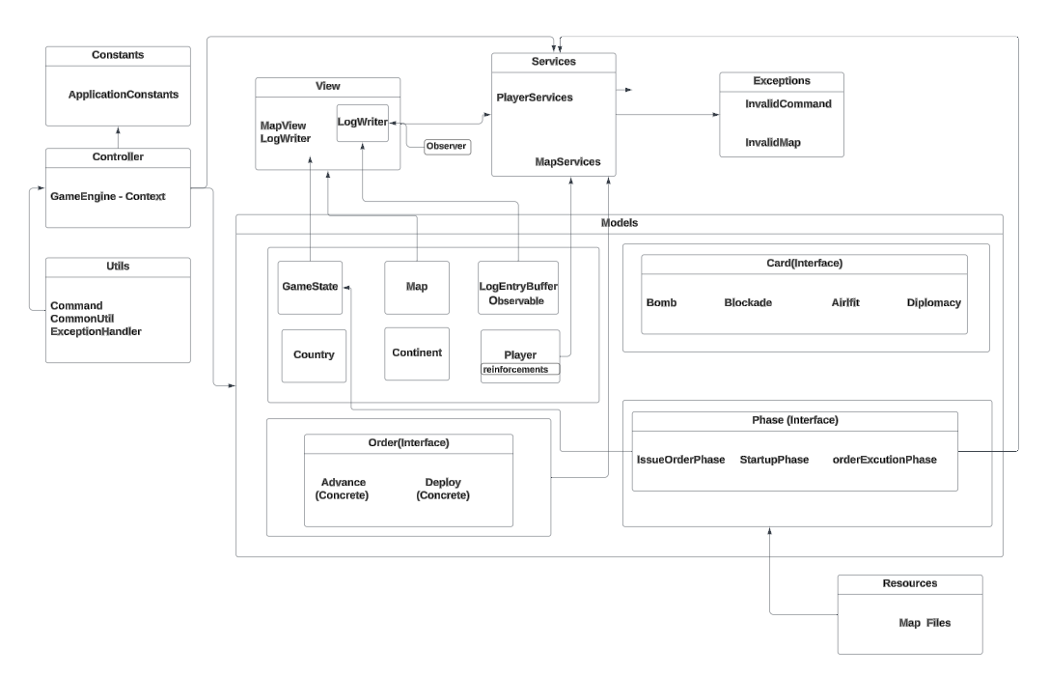
ARCHITECTURE DIAGRAM

Slide 4
STATE Pattern
The State Pattern is a behavioral design pattern that allows an object to alter its behavior when its internal state changes. This pattern is useful when an object's behavior depends on its state, and it needs to switch between different behaviors at runtime.
In the provided code:
The GameState class represents the state of the game. It contains various attributes such as players, map, and log.
The MapView class interacts with the GameState to display the current state of the game map.
The GameState class can transition between different states based on actions performed during the game, such as loading a map, editing a map, or saving a map.
By encapsulating each state (e.g., loading, editing, saving) in separate classes and allowing the GameState to delegate behavior to these classes, the State Pattern enables the GameState to change its behavior dynamically.

Slide 5
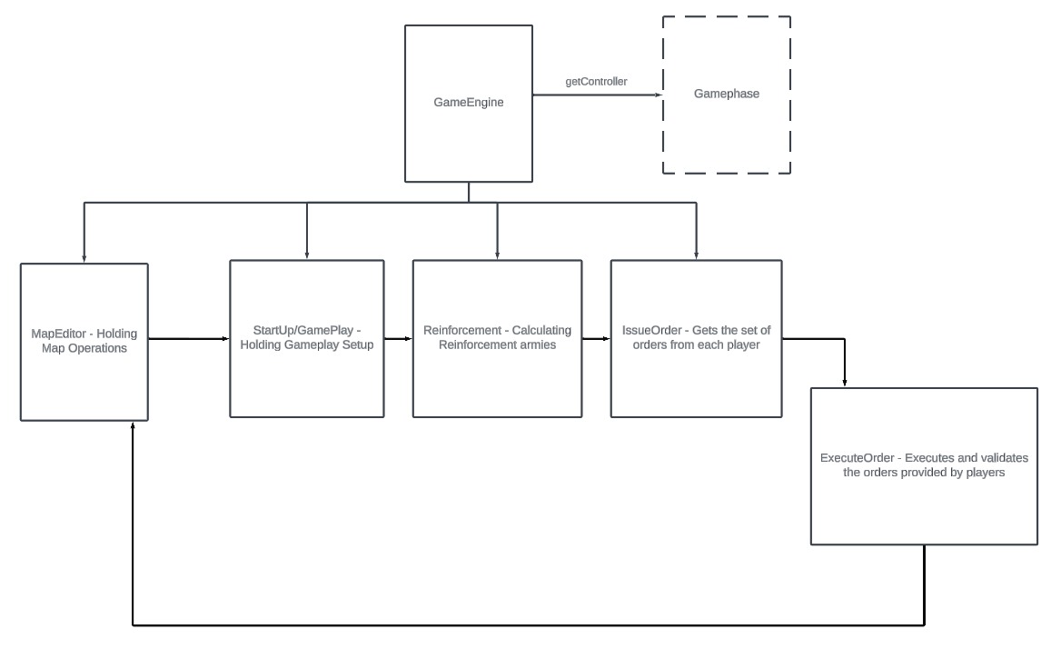
State Pattern:

Slide 6
Observer Pattern
The Observer Pattern is a behavioral design pattern where an object, known as the subject, maintains a list of dependents, called observers, and notifies them of any state changes, usually by calling one of their methods.
In the provided code:
The GameState class maintains a list of observers (e.g., MapView) that are interested in changes to the game state. When the game state changes (e.g., loading a map, updating the log), the GameState notifies its observers by calling their update methods.
The MapView class implements an update method to react to changes in the game state. For example, when the game map is updated, the MapView can re-render the map to reflect the changes.
This pattern enables loose coupling between the GameState and its observers, allowing for flexible and scalable designs where multiple observers can react to state changes independently.

Slide 7
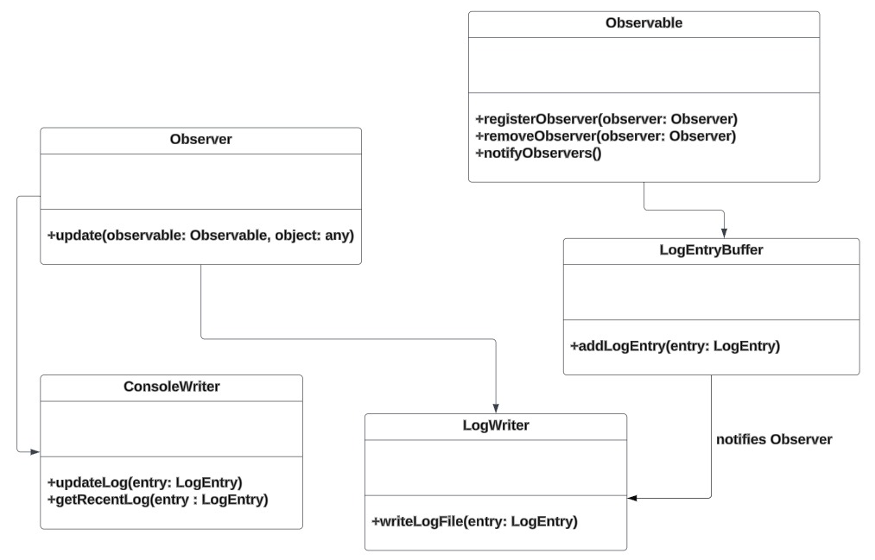
Observer Pattern:

Slide 8
Command Pattern
The Command Pattern is a behavioral design pattern that encapsulates a request as an object, thereby allowing parameterization of clients with queues, requests, and operations.
In the provided code:
The MapView class contains methods like renderPlayers() and showMap() that represent commands to render player information and display the game map, respectively.
These methods encapsulate specific actions that can be executed by invoking them. The MapView class acts as an invoker, and the methods act as commands that can be executed.
The MapView class can queue or store these commands and execute them later, providing flexibility and decoupling between the invoker and the receiver of the commands.

Slide 9
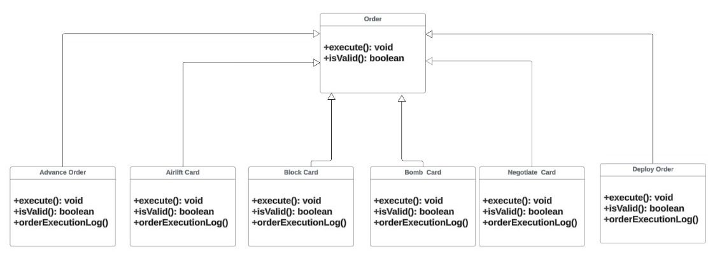
Command Pattern:

Slide 10
THANK YOU

